Slide 1
Java 4 WEB
Lesson 21 - Code Testing (Intro, Unit)

Slide 2
Lesson goals
What is “code testing” and why it’s important
Testing levels
Pros vs Cons
Unit testing
Mocking
Code Coverage
Working with IDE
Q&A

Slide 3
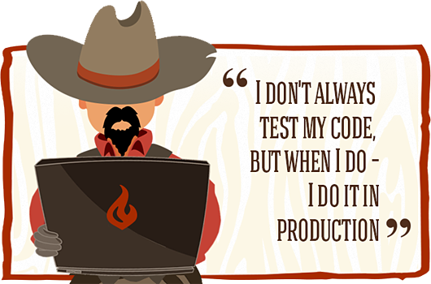
What is “code testing” and why it’s important
Scenario : “Let’s make a small fix!!!”
Action: Developer changes a “simple” line of code.
Result: This quick fix solve the problem but broke other parts of the code.

Slide 4
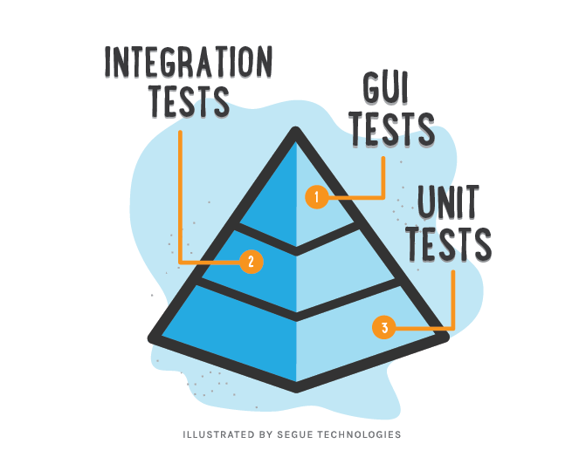
Testing levels

Slide 5
Pros vs Cons
Bugs preventing
Easy refactoring
Better code architecture
Documentation
Less debugging cases
Time saver
Money saver
Must have practice for big projects
Guarantee that your code is working as expected
Needs more time for coding
Require support
Possible overhead
Hard to write good tests
Hard to apply on legacy code

Slide 6


Testing libraries

Slide 7
Unit testing

Slide 8
Simple Unit Test Example
package io.testsgh.unittestexample;
class Calculator {
int add(int x, int y) {
return x + y;
}
}
package io.testsgh.unittestexample;
import org.testng.annotations.Test;
import static org.testng.Assert.*;
public class CalculatorTest {
@Test
public void testAdd() {
Calculator calculator = new Calculator();
int actualResult = calculator.add(1, 2);
int expectedResult = 3;
assertEquals(actualResult, expectedResult);
}
}

Slide 9
How to setup & run tests
Add test dependency for test lib:
repositories {
mavenCentral()
}
dependencies {
testCompile "org.testng:testng:7.0.0-beta3"
}
Directly from IDE (mostly used)
Via build system (Gradle task verification::test)
CI server to assure that nothing was broken

Slide 10

Working with IDE

Slide 11
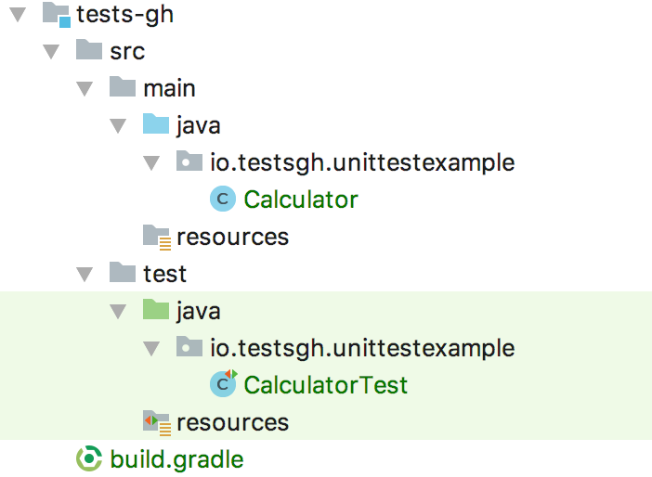
Test Sources conventions
Source code structure:

Slide 12
Code Convention in Tests
Test of class should be in same package in test source root
Tested class should have same name as tested class with suffix “Test”
Tested method names pattern test[feature being tested][behaviour expected]:
testAdd
testAddSuccess
testAdd_Success
testAddFail
testAdd_Fail
One convention for all tests

Slide 13
Test results verification
assertEquals(Object o1, Object o2)
assertNotEquals(Object o1, Object o2)
assertTrue(boolean condition)
assertFalse(boolean condition)
assertNull(Object o)
assertNotNull(Object o)
more in org.testng.Assert.*

Slide 14
Test configurations
public class CalculatorTest {
@Test
public void testAdd() {
Calculator calculator = new Calculator();
int actualResult = calculator.add(1, 2);
int expectedResult = 3;
assertEquals(actualResult, expectedResult);
}
}
Usage of @BeforeMethod annotation
Usage of @AfterMethod annotation

Slide 15
Method that throws exceptions
class Calculator {
int add(int x, int y) {
return x + y;
}
double sqrt(double x) {
if (x < 0) {
throw new IllegalArgumentException("x should be > 0");
}
return Math.sqrt(x);
}
}
Expected exception parameter for test method

Slide 16
Which code should be tested by Unit tests?
Yes
Business logic
Everything that contain conditions
No
Working with file system or DB
Working with some external services or internet

Slide 17
What you should not test
Other frameworks or libraries
Trivial code (get/set)
Code that has non deterministic results (Think Thread order or random numbers)

Slide 18
Good practices
One assert per test
Usage of parameters methods
Limit bounds test cases (especial for user input)
Reset components before each test
Test success cases and fail cases separately
Dependency injection through constructor

Slide 19
Mocking

Slide 20
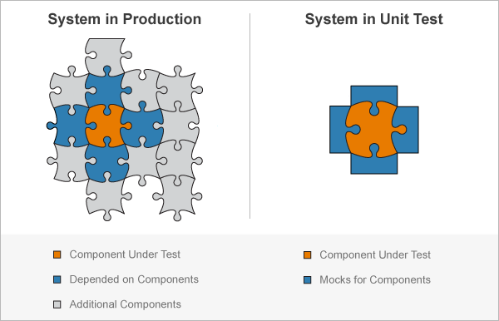

Slide 21


Mocking libraries

Slide 22
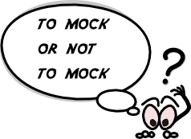
Mockito dependency
repositories {
mavenCentral()
}
dependencies {
testCompile "org.testng:testng:7.0.0-beta3 "
testCompile "org.mockito:mockito-core:2.25.1"
}

Slide 23
What is Mock ?
public interface Operation {}
public interface OperationWithOneArgument extends Operation {
Number calculate(Number argument);
}
public interface OperationWithTwoArguments extends Operation {
Number calculate(Number x, Number y);
}
class CalculatorWithOperations {
private final OperationWithOneArgument sqrtOperation;
private final OperationWithTwoArguments sumOperation;
CalculatorWithOperations(
OperationWithOneArgument sqrtOperation,
OperationWithTwoArguments sumOperation
) {
this.sqrtOperation = sqrtOperation;
this.sumOperation = sumOperation;
}
double add(Double x, Double y) {
Objects.requireNonNull(x);
Objects.requireNonNull(y);
return sumOperation.calculate(x, y).doubleValue();
}
double sqrt(double x) {
Objects.requireNonNull(x);
return sqrtOperation.calculate(x).doubleValue();
}
}

Slide 24
Argument matchers
any()
anyInt/String/etc()
any(Class c)
anyCollection/List/Set/Map()
eq()
More in class “org.mockito.ArgumentMatchers‘

Slide 25
AAA (arrange, act, assert) or “given-when-then”
@DataProvider(name = "testAddParameters")
public static Object[][] testAddParameters() {
return new Object[][]{
{1, 2, 3},
{2, 2, 4},
};
}
@Test(dataProvider = "testAddParameters")
public void testAdd(int x, int y, int expectedResult) {
//arrange - test initialisation + stubs/mocks creation
when(sumOperation.calculate(1, 2)).thenReturn(3);
//act - where the operation to be tested is performed
int actualResult = calculator.add(x, y);
//assert - received result assertion + mocks verification
verifyZeroInteractions(sqrtOperation);
assertEquals(actualResult, expectedResult);
}

Slide 26

Code Coverage

Slide 27
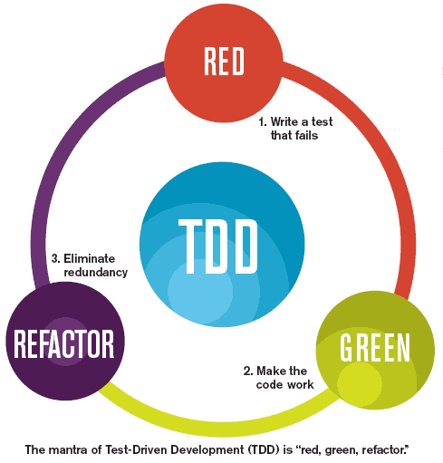
Test Driven Development
Simple sorting list example

Slide 28
Useful links
Basics of Unit Testing
Getting started with Mockito
Best practices for unit testing
The Pros & Cons of Test-Driven Development
Real life unit tests

Slide 29
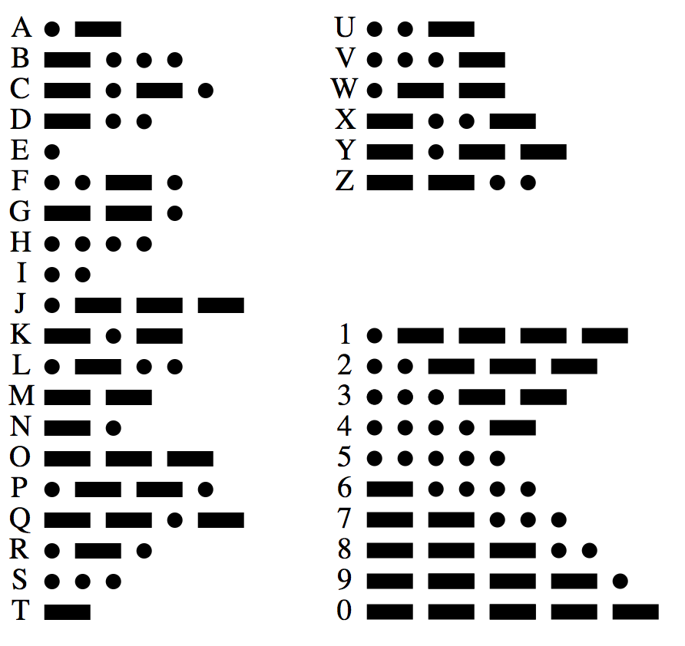
Home task 1
Write Morse abetque translator:
Use following alphabet relation, each Morse symbol should be separated by space.
Example: DC should be -.. -.-.
Use slash symbol ‘/’ as space between multiple words input.
Example: D C should be -.. / -.-.
Validate user input for nullability
When user input symbol not listed in alphabet, throw IllegalArgumentException
Write tests on translator and cover all code base (100%).

Slide 30
Home task 1 test cases
SOS
S O S
GeekHub
it is a good day to die
$0m*th!#g Br0k*#!
... --- …
... / --- / …
--. . . -.- .... ..- -...
.. - / .. ... / .- / --. --- --- -.. / -.. .- -.-- / - --- / -.. .. .
Incorrect input(exception expected)

Slide 31
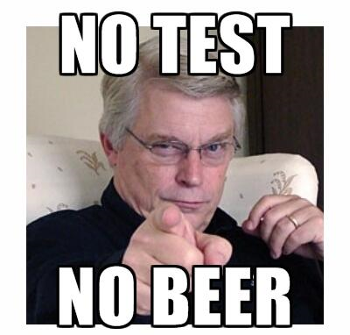
Q & A

